Slide 1
Leavening Agents
Chapter 21

Slide 2
Objectives
Vocabulary
Explain the purpose of leavening agents in baked goods
Identify natural leavening agents and describe how they work
Explain the chemical process by which baking soda and baking powder leaven baked goods
Describe the role in yeast leavening
Explain how quick breads are different from other baked products
Compare the leavening agents used in different types of cakes
Baking powder
Baking soda
Double acting baking powder
Quick breads
Fermentation
Single acting baking powder

Slide 3
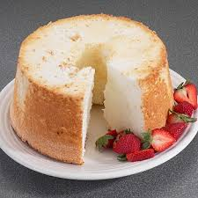
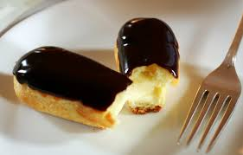
Leavening Agents
Steam
Air
Air – Gives baked goods a “lift”
Air is added by:
Sifting dry ingredients
Beating fat with sugar
Whipping batter
Steam – used in some recipes as a primary leavening agent.
Requires a very hot oven convert the liquid into steam
Steam forms and the batter expands around it. Baking coagulates the protein, setting the structure.

Slide 4
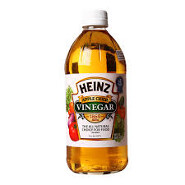
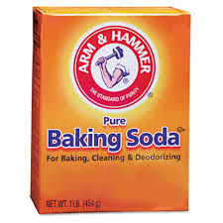
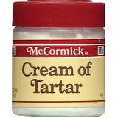
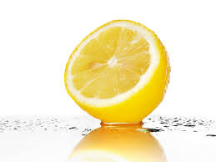
Leavening Agents using Carbon Dioxide
Baking Soda + Acid = Baked Goods
Baking Soda
Chemical Compound sodium bicarbonate
Releases sodium carbonate and carbon dioxide when heated
Baking soda always needs to be used with an acid, to alter the chemical reaction to prevent sodium carbonate from forming

Slide 5
Leavening Agents using Carbon Dioxide
Baking Powder
Chemical Compound that contains baking soda, dry acids, and starch or some other filler.
Single-acting – starts reacting as soon as liquid is added
Double-acting – contains two acids – one that reacts with old liquid and one that reacts with heat
http://video.about.com/chemistry/Differentiating-Baking-Soda-and-Baking-Powder.htm

Slide 6
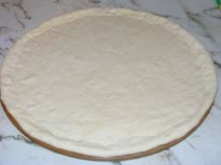
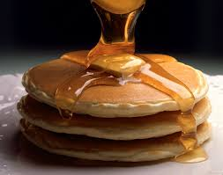
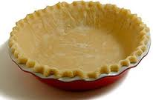
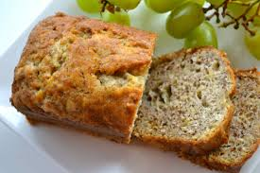
Making Leavened Products
Batters
Dough's
Pour batters – made with a nearly equal ratio of flour to liquid
Range from thin to hard to pour
Funnel cake
pancakes
Drop batters – two parts flour, one part liquid
Quick bread loaves
Some cookies
muffins
Soft dough's – three parts flour, one part liquid
Yeast breads
Pizza crusts
Biscuits
Stiff dough's – six to eight times as much flour as liquid
Scones
Pie crusts

Slide 7
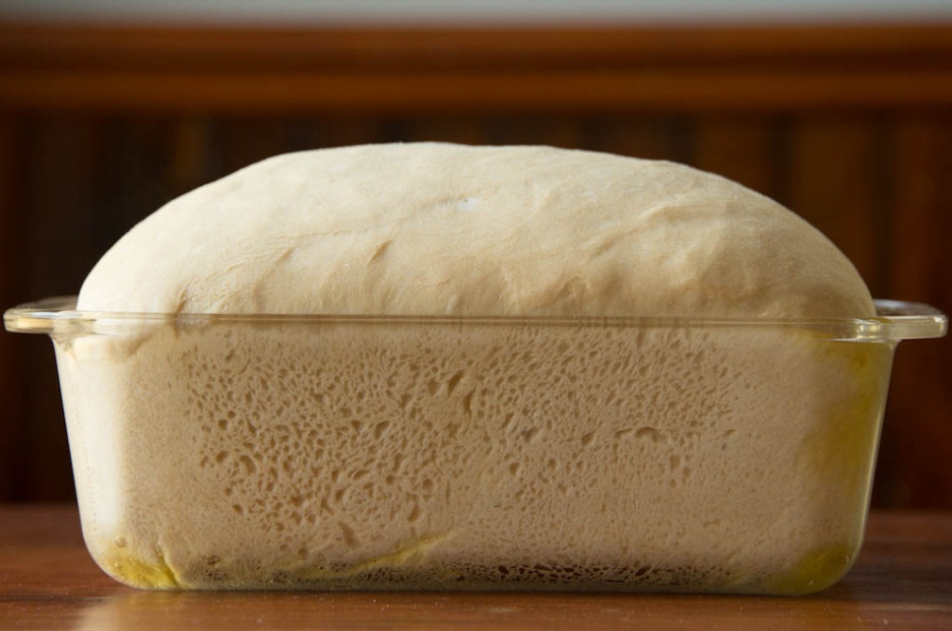
Yeast as a Leavening Agent
Yeast – microscopic organism that produces carbon dioxide through fermentation
Fermentation – a biological reaction that slowly splits compounds into simpler substances

Slide 8
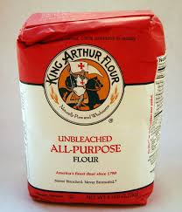
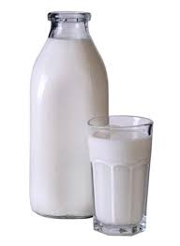
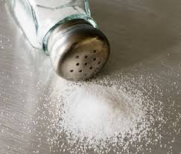
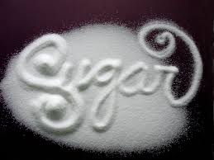
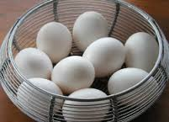
Making Yeast Products
Ingredient Purposes
Flour – provides structure
Liquid – provides medium that dissolves other ingredients and transports them to the yeast cells.
Salt – prevents enzymes from breaking down protein
Sugar - helps the crust brown and adds flavor
Fat - makes bread tender
Eggs - makes bread rich in texture and flavor

Slide 9
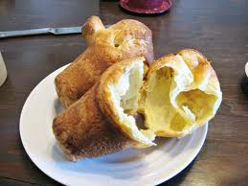
Quick Breads
Quick Breads are NOT made with yeast, they don’t need time to rise.
Made with steam or carbon dioxide that is produced with baking powder or baking soda.
Examples:
Muffins
Coffee cakes
Cake-like breads
Popovers
Biscuits
The History of Bread - The Chemistry of Baking Soda and Yeast (4:28)
http://www.youtube.com/watch?v=qylxpwNhFYI

